Slide 1
Writing for Biology Class
All materials taken from Knisely, Karin. (2009). Writing in Biology. Sinaur/Freeman.

Slide 2
Writing Hypotheses
Format If---, then----, because----. (note not all teachers include because.
If (independent variable aka explanatory variable… this variable explains or influences the response, e.g. time)
Then (dependent variable… this variable is affected by the imposed treatment, e.g. height, number of seeds, velocity of a reaction, etc.)
Because (prediction, guess, explanation of known causes)

Slide 3
Writing a hypothesis
Find key words or concepts
Example: you are working with sowbugs in dark and light conditions and a choice chamber and you know that sowbugs can be found under leaves in the shade.
Find the key words or concepts in Example 2
Example 2: you are working with enzymes and pH and you know that the pH of your mouth is neutral (pH 7) and the pH of your stomach is pH 2.

Slide 4
Writing a Hypothesis
Identify the independent variable (IV) and the dependent variable (DV) and the explanation or cause for the prediction (because).
Example: you are working with sowbugs (DV) in dark and light conditions (IV) and you know that sowbugs can be found under leaves in the shade (prediction).

Slide 5
Practice
Example 2: you are working with enzymes and pH and you know that the pH of your mouth is neutral (pH 7) and the pH of your stomach is pH 2.

Slide 6
Putting it all together
Example: you are working with sowbugs (DV) in dark and light conditions in a choice chamber (IV) and you know that sowbugs can be found under leaves in the shade (prediction).
If sowbugs are given a choice between light and dark conditions then sowbugs will be most likely choose the dark side of the choice chamber, because sowbugs are found under leaves.
Very wordy… can you tighten up the hypothesis?
Revision:

Slide 7
Practice
Example 2: you are working with enzymes and pH and you know that the pH of your mouth is neutral (pH 7) and the pH of your stomach is pH 2.
If

Slide 8
The Null Hypothesis
The Null Hypothesis is usually understood and rarely stated but reflects the idea that there will be NO change or NO effect of the independent variable on the experimental set up or treatment. The Null Hypothesis is not necessarily the “opposite” effect of the treatment, sometimes you have completely novel effects (example Rogaine (blood pressure) or Viagra (chest pain in men)).

Slide 9
Another Variable
Standardized or controlled variables: common environments, procedures or treatments (example: all subjects are freshmen, test given 4th period, same temperature…)

Slide 10
The Difference between the Treatment (experimental set up) and control groups:
Pea plants receiving variable concentrations (amounts) of gibberellic acid = treatment group… peas receiving only same volume of liquid with only water = control group.
Negative control: dwarf plants + no gibberellic acid (just = volume of water)
Positive control: wild type (normal height) plants + no gibberellic acid (just = volume of water)
Note: need to do research to determine range of concentrations of GA given.
Need multiple treatments (no less than 5), data collected from one plant isn’t statistically significant.

Slide 11
Knowing what to expect from an experiment…
Predicting what the outcome of an experiment will be if the hypothesis is upheld (because)
Adding GA (gibberellic acid) to dwarf plants will allow them to grow to the height of normal, wild type plants.
Positive result: expect dwarf plants to grow to normal range of height. Because GA is a plant growth hormone.
Negative result (Null Hypothesis supported): dwarf plants not affected by GA remain short because GA would not affect growth.
Negative control: (dwarf plants + no GA) expect dwarf plants
Positive control: (wild type + no GA) expect tall wild type plants.

Slide 12
Collection of appropriate data
(qualitative or quantitative- units)
Each observation in your lab journal contains the following information:
Investigator’s name(s)
The date (month, day, year)
The purpose
The procedure (in words or in flow chart)
Numerical data, with units of measurement, recorded in a data table
Drawings with dimensions and magnification, where appropriate. Structures are drawn in proportion to the whole object. Parts are labeled clearly. Observations about the appearance, color, texture, etc. are included.
Graphs, printouts, and gel images, etc.
Calculations (either handwritten or printouts).
A brief summary of the results.
Questions, possible errors, and other anecdotal notes.
Your notes should be detailed enough so that someone else would be able to replicate your data and understand your results.

Slide 13
What to do with raw data
Decide if the data is trustworthy or erroneous
You may need to repeat the experiment if data is untrustworthy
Quantitative data: Graph data to look for obvious patterns, try X-Y scatter and show trendlines if appropriate. Look at the slope (y=mx+b) to see if trends are positive or negative.
Qualitative data: Use bar graphs with categorical data (no units)
Statistics: mean, standard deviation, Chi-Square, standard error, etc.

Slide 14
What to think about when writing a discussion or conclusion..
do results support or refute hypotheses, or null hypothesis.
Compare results to the primary references you consulted before you developed your experiment.
Is there any difference between the control and the treatment group (supports null hypothesis).
Use primary research to provide support for your findings.
If your results were different take into account differing methods, organisms, and conditions.
Any sources or errors?
Revising original hypotheses to take into account new findings.
Designing new experiments to test the new hypotheses (or other experiments to provide further support for old hypothesis)

Slide 15
Writing Hints for Laboratory Write-ups
Use full sentences and well developed paragraphs.
Avoid listing materials and containers and elaborate procedures.
Example:
Six clean beakers were labeled with the following concentrations of sucrose and those solutions were created and placed in the appropriate beaker: 0, 7%, 14%, 21%, 28%, and 35%.
Revision:
The following sucrose solutions were prepared: 0, 7%, 14%, 21%, 28%, and 35%.

Slide 16
Example for writing procedures
Example:
To make the various solutions of sucrose, first tare the balance to 0.00 grams. Place the correct amount of sucrose for each solution (7 grams for 7%, 14 grams for 14 %, up to 35 grams for 35% sucrose) on the balance. Mix the sucrose in a clean 250 mL beaker with 50 mL of distilled water until the solution clears. Pour the solution in a 100 mL graduated cylinder and bring the volume up to 100 mL with distilled water. (belongs only in your journal)
Revision:
The following concentrations of sucrose were prepared for the diffusion and osmosis activity: 7%, 14%, 21%, 28%, and 35%.

Slide 17
Writing Titles for Lab Reports
Compose a title from the following information:
Lab 1, Sowbugs, Light and Dark Environments, Wet and Dry Environments, Choice Chambers, Preference Behavior
Revision:
Using a Choice Chamber to Determine Sowbug Environmental Preference

Slide 18
Faulty Titles
Lab 1
Quantitative Protein Analysis
The Assessment of Protein Content in an Unknown Sample
Egg White Protein Analysis
Revision:
Assessment of Protein Concentration in Egg While using the Biuret Method

Slide 19
Practice Writing Titles
pH of mouth, stomach, enzymes, optimal pH
Title?

Slide 20
Writing Tips for the Introduction
Stating the purpose (the first statement in an abstract or introduction). And always cite published sources.
Example 1:
The experiment performed by students dealt with how different wavelengths of light affect seed germination.
Revision:
The purpose of the experiment was to determine how different wavelengths of light affect seed germination

Slide 21
Writing the Purpose (con’t.)
Example 2:
The purpose of this experiment is to become acquainted with new laboratory techniques such as protein analysis, serial dilutions, and the use of a spectrophotometer.
Revision:
The purpose of this experiment was to use the biuret assay to determine protein concentrations in egg white.

Slide 22
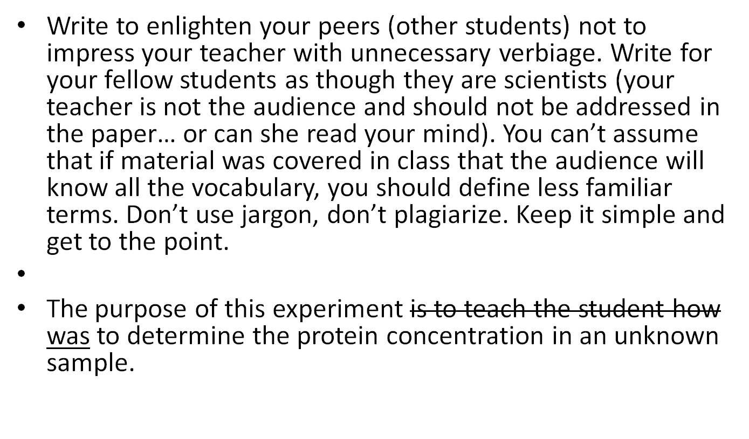
Other Helpful Hints

Slide 23
More Hints
Write in past tense, you already completed the lab or experiment.
Use passive voice so the emphasis is on the experiment not you the experimenter.
Passive voice: The potatoes were peeled and sliced. (Good)
Active voice: We peeled and sliced the potatoes. (BAD)
Avoid all pronouns (unless you are sure the pronoun applies to the last stated noun.)

Slide 24
Using Numbers in Writing
Numbering conventions:
Use numbers to express any quantity… Except:
at the beginning of a sentence or when adjacent numbers occur
Example: The solution was divided into four 250 mL flasks.
If number is used in a “non” numerical sense.
Example: One of the treatments…
When the number expresses rank: Example: The first, second,…
When the number is a fraction: Example: Nearly three-quarters of the plants…
Use scientific notation for very large and very small numbers… instead of writing 5 million, use 5 x 10⁶.
Use decimals for a value less than one, and show one’s place… Example 0.05 not .05.

Slide 25
Clarity in Writing
(avoiding redundancy)
Redundant | Revised
It is absolutely essential | It is essential
Mutual cooperation | Cooperation
Totally unique | Unique
The solution was obtained and transferred | The solution was transferred

Slide 26
Empty Phrases (wasted words)
Empty | Concise
A majority of | Most
As soon as | When
At all times | Always
Based on the fact that | Because
For this reason | So
In fact | Don’t use at all
Functions to, serves to | Don’t use at all
It is interesting to note that | Don’t use at all

Slide 27
Empty Phrases (con’t).
Empty | Concise
Referred to as | Called
With the exception of | Except
Came to the conclusion | Concluded
With the result that | So that
At a much greater rate than | Faster
So as to | To
Despite the fact that | Although, though
At the present | now

Slide 28
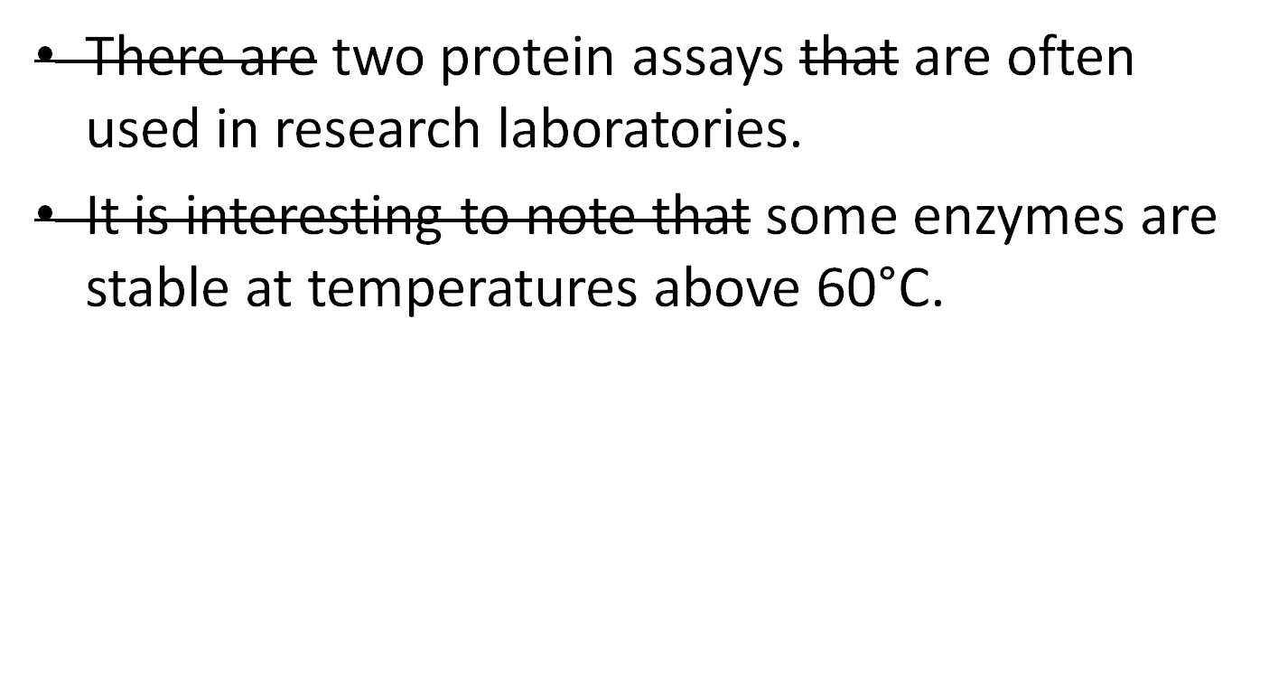
Examples of Clarity

Slide 29
Connecting Words and Repetition Improve Transitions between Paragraphs
Connecting words: however, thus, although, in contrast, similarly, on the other hand, in addition to, and furthermore.
Example:
Catalase is an enzyme that breaks down hydrogen peroxide in both plant and animal cells. Low or high temperature can lower the rate at which catalase can react with the hydrogen peroxide. In optimal conditions, the enzyme functions at a rate that will prevent any substantial buildup of the toxin. If the temperature is too low, the rate will be too slow, but the high temperatures lead to the denaturation of the enzyme.

Slide 30
Revision
Revision:
Catalase is an enzyme that breaks down hydrogen peroxide in both plant and animal cells. One of the factors that affect the rate of this reaction is temperature. At optimal temperatures, the rate is sufficient to present substantial buildup of the toxic hydrogen peroxide. If the temperature is too low, however, the rate will be too slow, and the hydrogen peroxide accumulates in the cell. On the other hand, high temperatures may denature the enzyme.

Slide 31
Grammar Advice:
Make sure subject (nouns) and verbs agree.
Example: the height of the lamps was (not were)
(height is singular…. Therefore use “was”…)
Write in complete sentences… need a subject and a verb. Do not leave dependent clauses unfinished. If your sentence starts with subordinate words (after, although, because, before, but, if, so that, though, unless, until, when ,were, who, or which), you will need another clause to finish the sentence.
Revise run-on sentences (two or more independent clauses) without proper punctuation.
Insert a comma and a coordinating conjunction (and, but, or, nor, for, so, or yet)
Use a semicolon or a colon.
Make two separate sentences.
Rewrite the sentence.

Slide 32
Run on Sentence Help
Example:
The class data for the Bradford method of measuring protein concentrations were scattered, those for the biuret method were closer.
Revision 1: The class data for the Bradford method of measuring protein concentrations were scattered, but those for the biuret method were closer. (Use a coordinating conjunction).
Revision 2: The class data for the Bradford method of measuring protein concentrations were scattered; those for the biuret method were closer. (Use a semi-colon).

Slide 33
Word Usage Issues (the correct word for the correct situation)
Affect vs. Effect.
Affect is a verb that means “to influence.” Example: Temperature affects enzyme activity.
Effect can be a noun, effect means “result,” if effect is used as a verb “to cause.” Example (noun): We studied the effect of temperature on enzyme activity. Example (verb): High temperature effected a change in the shape of the enzyme, which destroyed the enzyme’s activity.

Slide 34
Word Usage Issues (con’t).
Datum (singular), data (plural)
Fewer vs. less. Use fewer when a quantity can be counted. Use less when the quantity is unknown.
Do not use contractions in formal writing. Use it is instead of it’s.
Lowered vs. raised. (transitive verbs require a direct object, a noun to act on. Example: Wrong: The fish’s body temperature lowered the response to the cold water. Correct: The cold water lowered the fish’s body temperature.

Slide 35
Word Usage (con’t).
Than vs. then. This is an expression used to compare two things. Example: Collisions between molecules occur more frequently at high temperature then at low temperatures. Then means “next in line.” Example: First the protein is added to the test tube, then the biuret solution is added.
That vs. which. Use that when you are referring to a specific group (do not use a comma). Use which when referring to additional information (use a comma).
Example:
  The Bradford assay, which is one method for measuring protein concentrations, requires only a amount of a sample.
  Example: The samples that had high readings were diluted. (That refers specifically to “the samples” a specific group).

Slide 36
Spelling Advice
Wrest a Spell
Eye halve a spelling chequer
It came with my pea sea
It plainly marques four my revue
Miss steaks eye kin knot sea.
Eye strike a key and type a word
And weight four it two say
Weather eye am wrong oar write
It shows me strait a weigh.

Slide 37
Spelling Advice….
As soon as a mist ache is maid
It nose bee fore two long
And eye can put the error rite
Its rare leas ever wrong.
Eye have run this poem threw it
I am shore your pleased two no
Its letter perfect awl the weigh
My chequer tolled me sew.
-Sauce unknown

Slide 38
Global Writing Advice
Words and phrases
Make them concise and descriptive.
Use scientific words when appropriate. Define terms that are unfamiliar to your audience. Avoid jargon and anthropomorphism.
Watch out for common confused word pairs (e.g. effect and affect).
Avoid clichés, slang, and abbreviations.
Do not use contractions in formal writing.

Slide 39
Global Advice (con’t).
Sentences
Eliminate wordiness.
Vary sentence structure and length to avoid monotony.
Use passive and active voice appropriately.
Use past and present tense appropriately.
Paragraphs
Each paragraph focuses on one topic.
The first sentence introduces the topic.
Subsequent sentences support the topic sentence.
Connecting phrases are use to achieve good flow between sentences.

